Slide 1

DNSC 6290 Customer Analytics, Fall 2021
Lecture 3
Instructor: Ali Pilehvar, Ph.D.
9/16/2021
Growth and User Acquisition

Slide 2
Office hour moving forward
Wednesday 7pm-8 pm EST
Monday 7:30-8:30 am EST
Notes:
Now we are done with metrics, frameworks and business models, time for us to get int measyrement of first part of the growth journey and is ACQ

Slide 3
Agenda for today
10 min discussion from last week
Customer Acquisition Cost (CAC)
Calculating CAC for Different marketing acquisition channels
In-class case study
The importance of Network effects in two-sided marketplace businesses
Project team Spreadsheet here
Homework 2 will be posted after the class
Notes:
Now we are done with metrics, frameworks and business models, time for us to get int measyrement of first part of the growth journey and is ACQ

Slide 4
10 min discussion from last week

Slide 5
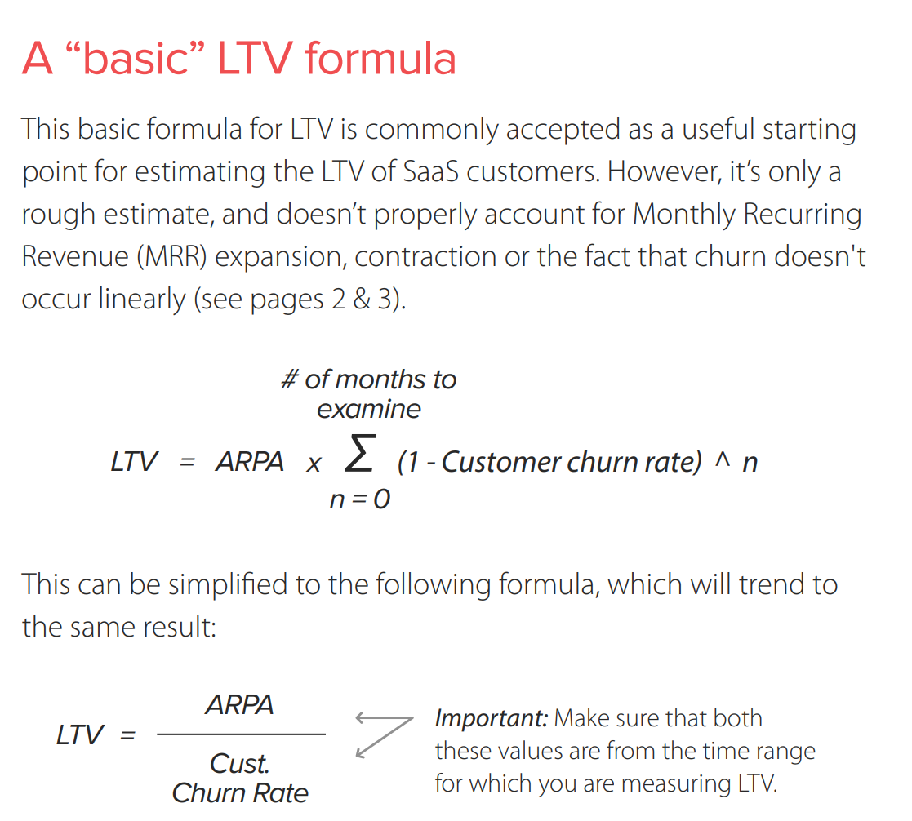

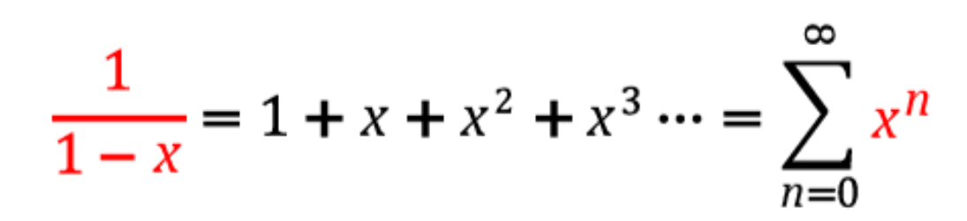
More about the LTV (life-time value) of customers
Source: https://blog.chartmogul.com/wp-content/uploads/2015/04/ChartMogul-Ultimate-Guide-to-SaaS-Customer-LTV.pdf
Notes:
https://blog.chartmogul.com/wp-content/uploads/2015/04/ChartMogul-Ultimate-Guide-to-SaaS-Customer-LTV.pdf

Slide 6
Learnings from last week
a16z Podcast: The Basics of Growth — User Acquisition
Reading: AARRR framework
Reading: Hooked: How to Build Habit-Forming Products
Video: How to Increase The Lifetime Value (LTV) of Your SaaS Customers
Video: Nine Business Models and the Metrics Investors Want
Reading: Metrics for a two-sided marketplace product

Slide 7
Customer Acquisition Cost (CAC):
The One Metric That Can Determine Your Company’s Fate
Notes:
https://neilpatel.com/blog/customer-acquisition-cost/

Slide 8


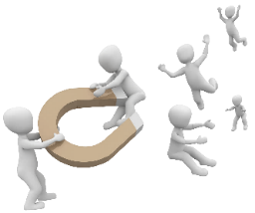
Companies do not grow themselves, entrepreneurs grow them
Founders/growth marketers should find the best place acquiring the most relevant and fitted customers to their business and double down on those channels
Paid marketing tactics could be a good starting point to find product-market fit in the short-term, but it’s not sustainable in a long-term!
Drivers in Growth Equation
Monthly acquired customers (new number you gain)
Monthly customers retained from previous month (Active customers)
[churn is part of this]
Monthly customers resurrected from past (inactive customers)
Notes:
https://medium.com/the-inflection-points/how-to-project-your-startups-growth-b05004d3e710

Slide 9
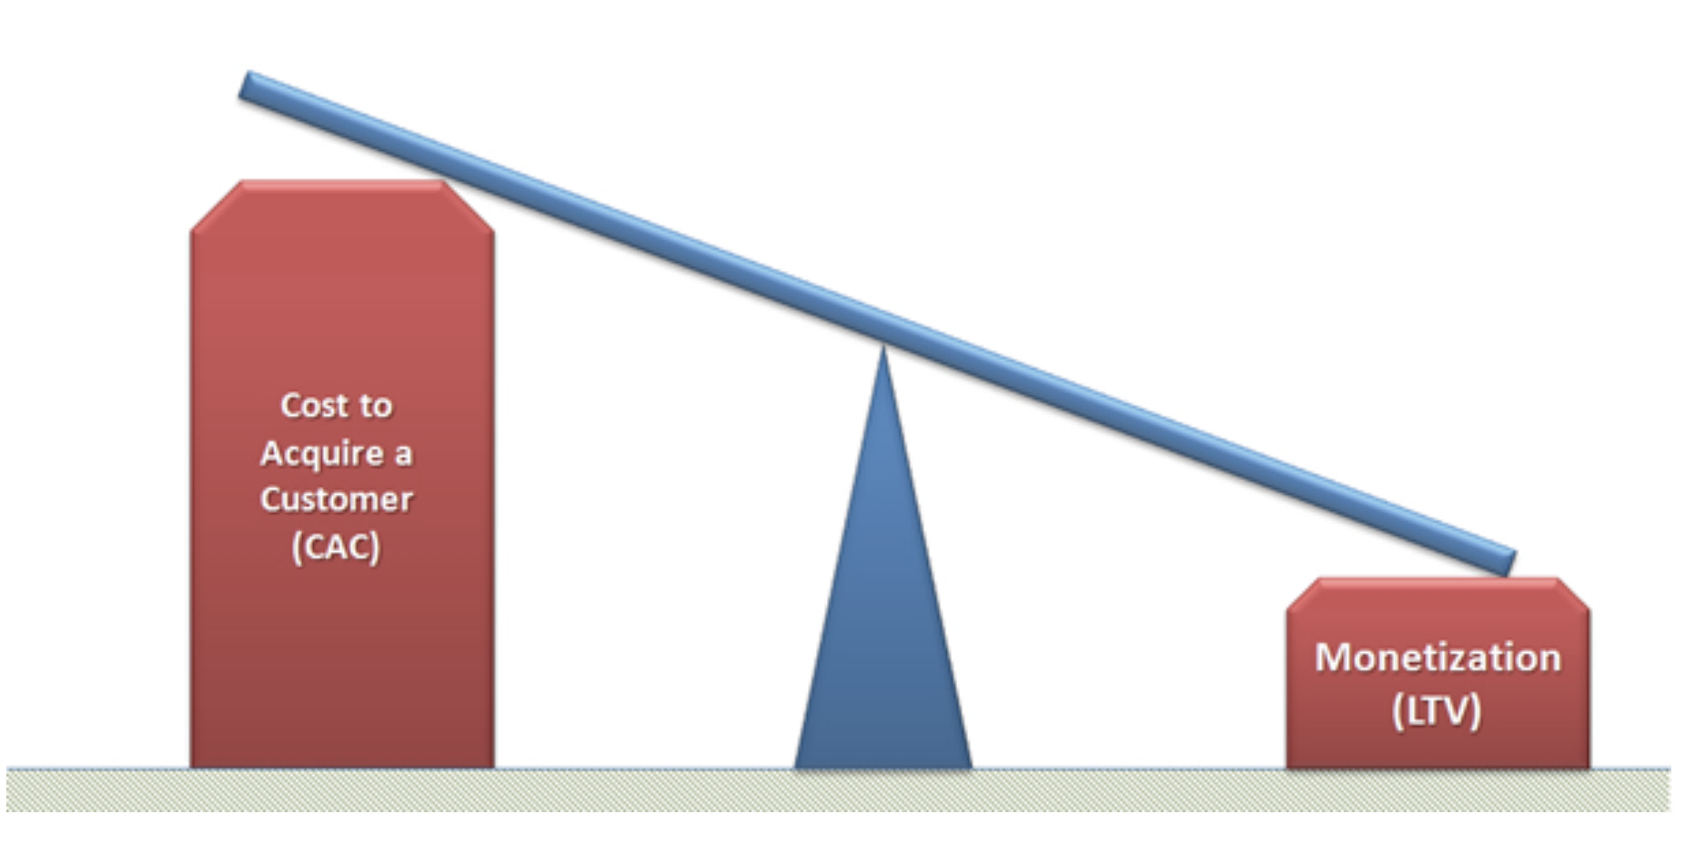
CAC is the cost of convincing a potential customer to buy a product or service.
Customer Acquisition Cost (CAC) is simply all costs spent to acquire new customers divided by number of new customers acquired during the same period.
It is NOT difficult to figure that business model fails when CAC (the cost to acquire customers) exceeds LTV (lifetime value of customers or the ability to monetize those customers)
Source: https://www.forentrepreneurs.com/startup-killer/
Notes:
https://www.forentrepreneurs.com/startup-killer/

Slide 10
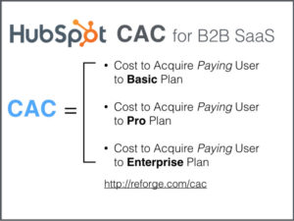
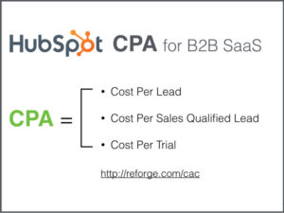
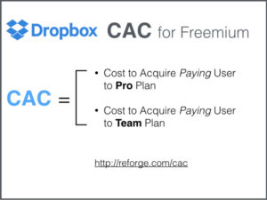
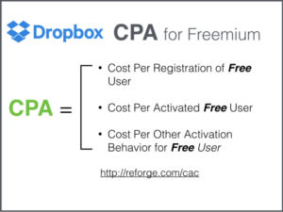
CAC (Customer Acquisition Cost) versus CPA (Cost Per Acquisition)
CAC: Cost to acquire a customer
(a buyer of an e-commerce, paying customer in SaaS business)
CPA: Cost to acquire something that is not customer (e.g., registrants, bidders, users)

Slide 11
CAC is important for both investors and companies- it determines the profitability of Unit Economics
 | Q1FY17 | Q2FY17 | Q3FY17 | Q4FY18 | Q1FY18 | Q2FY18 | Q3FY18
Revenue Per Customer during 2 quarters | $200 | $220 | $250 | $280 | $350 | $400 | $440
Total Paid Marketing cost | $80,000 | $96,800 | $117,128 | $141,725 | $171,487 | $207,499 | $251,074
Number of Paid New Customers | 300 | 354 | 404 | 460 | 524 | 629 | 762
Number of non-paid New Customers (free Channels) | 700 | 900 | 1300 | 1900 | 2300 | 2550 | 2700
CAC | $267 | $273 | $290 | $308 | $327 | $330 | $330
Blended CAC | $80 | $77 | $69 | $60 | $61 | $65 | $73
Looking into only blended CAC could be misleading as it might mask the true CAC from paid channels.
The company reaches to break-even point at Q1FY18 (CAC~=LTV)
Break-even point
Notes:
Most companies need to burn cash for marketing? Should VC invest? They can better off take a loan maybe
Let’s look at the economics in 2 quarters for each customer

Slide 12
CAC example- AdWords in an e-commerce company
 | Monthly Numbers | Scenario 1 | Scenario 2
 | Total Visitors | 10,000 | 10,000
 | SEM* Cost per click (CPC) | $0.60 | $1
 | Registration Conversion | 2% | 2%
 | Purchase conversion | 20% | 20%
 | Marketing cost
 | Number of sale and marketing staff | 5 | 3
 | Salary of each staff | $7,000 | $7,000
 | SEM Marketing Spend* | $6,000 | $6,000
 | Customer base
 | Number of Registration | 200 | 200
 | Number of paid customers | 40 | 40
 | Customer Acquisition Cost (CAC)
 | With headcount costs | $1,025 | $775
 | Without headcount costs | $150 | $250
Scenario 2 is better when accounting for everything
* SEM (Search Engine Marketing) is the process of gaining website traffic by purchasing ads on search engines.
The direct cost of marketing staff should be included when calculating the CAC ( in-house staff versus outside agencies)

Slide 13
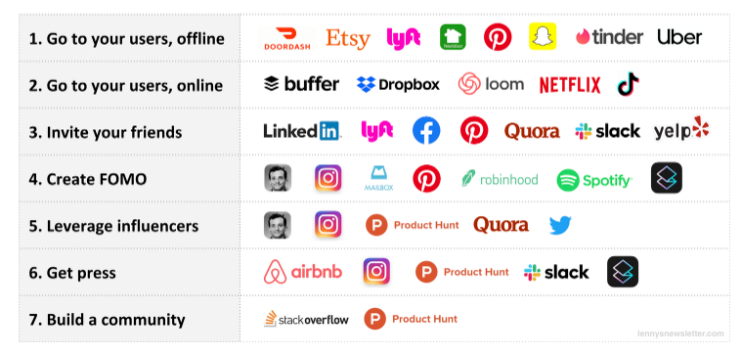
Big consumer apps get their first 1,000 users via different channels and tactics
Takeaways from Lenny Rachitsky’s research:
Just seven strategies account for every consumer apps’ early growth.
Most startups found their early users from just a single strategy. A few like Product Hunt and Pinterest found success using a handful.
Source: https://www.lennyrachitsky.com/p/how-the-biggest-consumer-apps-got
Notes:
More are: PR, TV/Radio + Blogs
https://www.disruptiveadvertising.com/marketing/marketing-channels/
https://blog.thomasnet.com/display-search-social-ppc-advertising

Slide 14
Avg CAC benchmark across different industries
Source: https://www.entrepreneur.com/article/225415
Notes:
https://www.propellercrm.com/blog/customer-acquisition-cost
https://www.entrepreneur.com/article/225415

Slide 15
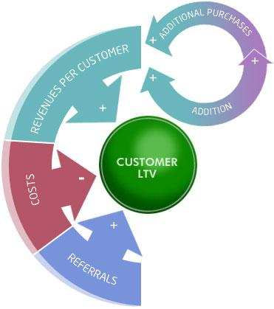
LTV to CAC Ratio
User’s LTV (life-time value) is the amount of value a customer contributes to your business over their lifetime – which starts with a new customer’s first purchase or contract and ends with the “moment of churn.”
Low CAC and maximizing LTV is so important to maintain a healthy and profitable business.
The ratio should always be at least 3:1.
User’s LTV =CLV (customer lifetime value)
Source: https://www.propellercrm.com/blog/customer-acquisition-cost
Notes:
https://www.propellercrm.com/blog/customer-lifetime-value-clv
https://www.propellercrm.com/blog/customer-acquisition-cost

Slide 16



The danger of relying on Avg CAC numbers without any segmentation
It is all about segmentation, segmentation and segmentation!
Segmentation based on customer types/attribute: Different types of customers behave very differently and might have different purchase intent and pain points to solve [this is more significant for enterprise and B2B products]
Segmentation based on the acquired channels: Different acquisition channels could have different nature/characteristics and produce very different CAC based on their costs, conversion rates, and other factors.
Segmentation based on geographic and location: The location of the customer can have a large effect on your CAC (countries, regions, languages)
Notes:
https://brianbalfour.com/essays/average-cac-mistakes-growth

Slide 17
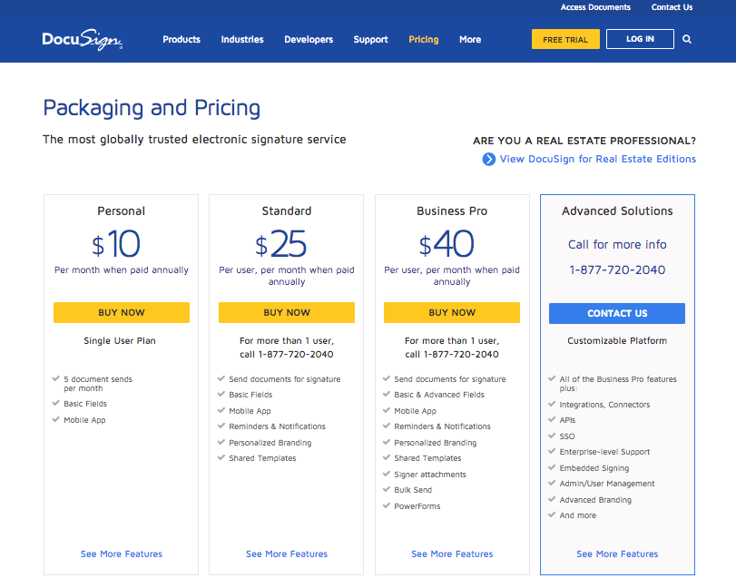
The DocuSign example- segmenting by customer type
They create different segments of target customers
They do different marketing efforts and tactics to acquire new customers for each segment
They should be able to calculate the CAC separately for each customer segment
Source: https://brianbalfour.com/essays/average-cac-mistakes-growth
Notes:
s shown on their pricing page, their tiers cover the following:
Personal $10/month – Likely targeted at individual professionals, sole proprietors, contractors and very small businesses.
Standard $25/month – Likely targeted at Mid Market companies.
Business Pro $40/month – Likely targeted at companies with power users (i.e. Law Firms).
Enterprise – Likely targeted for very large companies like the Fortune 1000.
https://brianbalfour.com/essays/average-cac-mistakes-growth

Slide 18
The DocuSign example-cont’d
 | DocuSign Example
 | Jan | Feb | Mar | April | May | June | July | Aug | Sept | Oct
Marketing Expenses (divided into 4 for each customer type) | $10,450 | $11,892 | $12,347 | $12,395 | $13,538 | $10,385 | $10,395 | $13,485 | $12,347 | $13,538
Sales Expenses (20% to pro, 80% to enterprise) | $30,122 | $34,321 | $38,943 | $38,234 | $40,438 | $44,784 | $48,348 | $44,321 | $44,756 | $44,943
-- Free Trial Support (only for enterprise) | $8,000 | $8,000 | $8,000 | $8,000 | $8,000 | $8,000 | $8,000 | $8,000 | $8,000 | $8,000
Total CAC Expenses | $48,572 | $54,213 | $59,290 | $58,629 | $61,976 | $63,169 | $66,743 | $65,806 | $65,103 | $66,481
Total New Customers | 421 | 431 | 467 | 449 | 457 | 498 | 457 | 438 | 432 | 419
-- Personal | 211 | 224 | 250 | 232 | 243 | 285 | 233 | 211 | 212 | 203
-- Standard | 184 | 184 | 184 | 184 | 184 | 184 | 184 | 184 | 184 | 184
-- Business Pro | 23 | 19 | 30 | 28 | 22 | 25 | 35 | 40 | 32 | 30
-- Advanced (Enterprise) | 3 | 4 | 3 | 5 | 8 | 4 | 5 | 3 | 4 | 2
Notes:
s shown on their pricing page, their tiers cover the following:
Personal $10/month – Likely targeted at individual professionals, sole proprietors, contractors and very small businesses.
Standard $25/month – Likely targeted at Mid Market companies.
Business Pro $40/month – Likely targeted at companies with power users (i.e. Law Firms).
Enterprise – Likely targeted for very large companies like the Fortune 1000.
https://brianbalfour.com/essays/average-cac-mistakes-growth

Slide 19
Avg CAC is misleading as it would NOT say how the cost is growing over time for each customer segment
 | DocuSign Example
 | Jan | Feb | Mar | April | May | June | July | Aug | Sept | Oct
Marketing Expenses (divided into 4 for each customer type) | $10,450 | $11,892 | $12,347 | $12,395 | $13,538 | $10,385 | $10,395 | $13,485 | $12,347 | $13,538
Sales Expenses (20% to pro, 80% to enterprise) | $30,122 | $34,321 | $38,943 | $38,234 | $40,438 | $44,784 | $48,348 | $44,321 | $44,756 | $44,943
-- Free Trial Support (only for enterprise) | $8,000 | $8,000 | $8,000 | $8,000 | $8,000 | $8,000 | $8,000 | $8,000 | $8,000 | $8,000
Total CAC Expenses | $48,572 | $54,213 | $59,290 | $58,629 | $61,976 | $63,169 | $66,743 | $65,806 | $65,103 | $66,481
Total New Customers | 421 | 431 | 467 | 449 | 457 | 498 | 457 | 438 | 432 | 419
-- Personal | 211 | 224 | 250 | 232 | 243 | 285 | 233 | 211 | 212 | 203
-- Standard | 184 | 184 | 184 | 184 | 184 | 184 | 184 | 184 | 184 | 184
-- Business Pro | 23 | 19 | 30 | 28 | 22 | 25 | 35 | 40 | 32 | 30
-- Advanced (Enterprise) | 3 | 4 | 3 | 5 | 8 | 4 | 5 | 3 | 4 | 2
Average CAC | $115 | $126 | $127 | $131 | $136 | $127 | $146 | $150 | $151 | $159
-- Personal CAC
-- Standard CAC
-- Business Pro CAC
-- Advanced Enterprise CAC
From looking only at the Avg CAC, the avg CAC is increasing in time!
Notes:
s shown on their pricing page, their tiers cover the following:
Personal $10/month – Likely targeted at individual professionals, sole proprietors, contractors and very small businesses.
Standard $25/month – Likely targeted at Mid Market companies.
Business Pro $40/month – Likely targeted at companies with power users (i.e. Law Firms).
Enterprise – Likely targeted for very large companies like the Fortune 1000.
https://brianbalfour.com/essays/average-cac-mistakes-growth

Slide 20
Segmenting the data into different customer type would give us more insight on how each customer segment are doing!
 | DocuSign Example
 | Jan | Feb | Mar | April | May | June | July | Aug | Sept | Oct
Marketing Expenses (divided into 4 for each customer type) | $10,450 | $11,892 | $12,347 | $12,395 | $13,538 | $10,385 | $10,395 | $13,485 | $12,347 | $13,538
Sales Expenses (20% to pro, 80% to enterprise) | $30,122 | $34,321 | $38,943 | $38,234 | $40,438 | $44,784 | $48,348 | $44,321 | $44,756 | $44,943
-- Free Trial Support (only for enterprise) | $8,000 | $8,000 | $8,000 | $8,000 | $8,000 | $8,000 | $8,000 | $8,000 | $8,000 | $8,000
Total CAC Expenses | $48,572 | $54,213 | $59,290 | $58,629 | $61,976 | $63,169 | $66,743 | $65,806 | $65,103 | $66,481
Total New Customers | 421 | 431 | 467 | 449 | 457 | 498 | 457 | 438 | 432 | 419
-- Personal | 211 | 224 | 250 | 232 | 243 | 285 | 233 | 211 | 212 | 203
-- Standard | 184 | 184 | 184 | 184 | 184 | 184 | 184 | 184 | 184 | 184
-- Business Pro | 23 | 19 | 30 | 28 | 22 | 25 | 35 | 40 | 32 | 30
-- Advanced (Enterprise) | 3 | 4 | 3 | 5 | 8 | 4 | 5 | 3 | 4 | 2
Average CAC | $115 | $126 | $127 | $131 | $136 | $127 | $146 | $150 | $151 | $159
-- Personal CAC | $12 | $13 | $12 | $13 | $14 | $9 | $11 | $16 | $15 | $17
-- Standard CAC | $41 | $47 | $53 | $52 | $55 | $61 | $66 | $60 | $61 | $61
-- Business Pro CAC | $376 | $518 | $363 | $384 | $521 | $462 | $351 | $306 | $376 | $412
-- Advanced Enterprise CAC | $11,570 | $9,607 | $14,080 | $8,337 | $5,467 | $11,606 | $9,855 | $15,609 | $11,723 | $23,669
What would be the reasons for increase in Avg CAC (from $115 in Jan to $160 in Oct)?
Notes:
s shown on their pricing page, their tiers cover the following:
Personal $10/month – Likely targeted at individual professionals, sole proprietors, contractors and very small businesses.
Standard $25/month – Likely targeted at Mid Market companies.
Business Pro $40/month – Likely targeted at companies with power users (i.e. Law Firms).
Enterprise – Likely targeted for very large companies like the Fortune 1000.
https://brianbalfour.com/essays/average-cac-mistakes-growth

Slide 21
Should always watchout for any change % in customer mix over time
Notes:
s shown on their pricing page, their tiers cover the following:
Personal $10/month – Likely targeted at individual professionals, sole proprietors, contractors and very small businesses.
Standard $25/month – Likely targeted at Mid Market companies.
Business Pro $40/month – Likely targeted at companies with power users (i.e. Law Firms).
Enterprise – Likely targeted for very large companies like the Fortune 1000.
https://brianbalfour.com/essays/average-cac-mistakes-growth

Slide 22
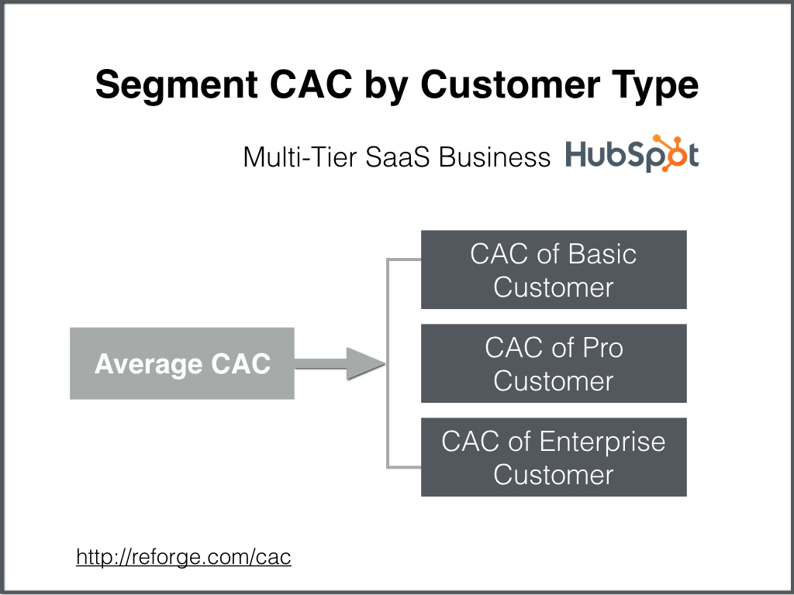
A lot of SaaS products serve multiple segments of the market: small, mid market and enterprise

Slide 23
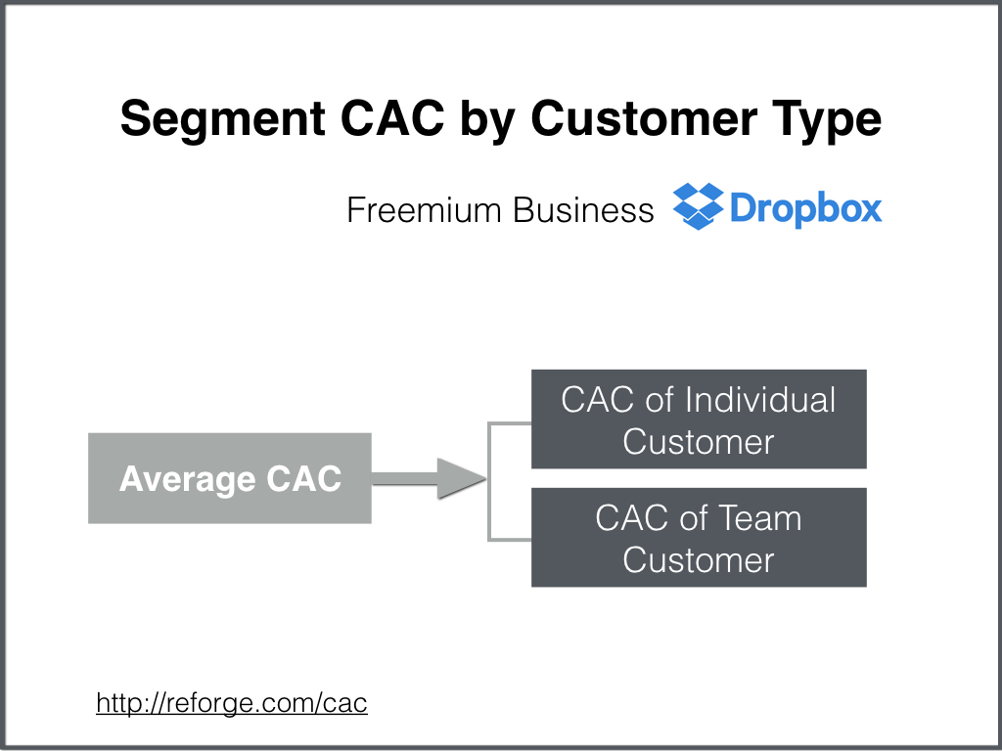
In the fermium business model, there could be different types of free and paying customer to target

Slide 24
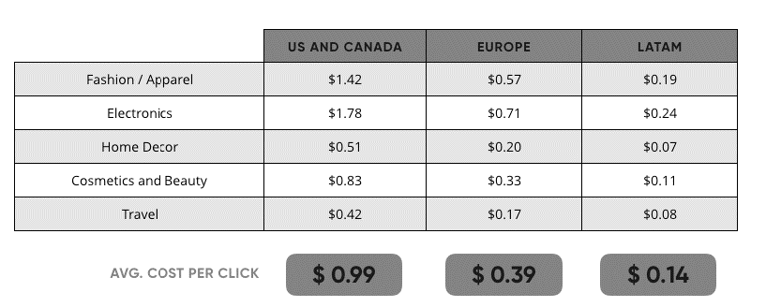
The location of the potential customers can impact CAC or CPC (cost per click) significantly
One study from LABS (2018) compared avg acquisition cost across three markets (United States +Canada, Europe and Latin America) and 5 different industries (Fashion, Electronics, Decor, Cosmetics and Beauty, and Travel)
Due to less market saturation in Latin America, Latin America has the lowest CPC.
Source: https://labs.ebanx.com/en/articles/inside/cac-is-cheaper-in-latin-america-learn-why/

Slide 25
Calculating CAC for different Marketing Acquisition Channels

Slide 26

Different acquisition channels can produce different CAC and outcome
Display
Paid search
Paid Social
SEO (free)
Visits
Sign up
Buyers or paid users
Visits
Sign up
Buyers or paid users
Visits
Sign up
Buyers or paid users
Visits
Sign up
Buyers or unpaid users
CAC (visitor, Sign up, Buyer)
Notes:
Could be other channels as well
https://neilpatel.com/blog/customer-acquisition-cost/

Slide 27
Marketing acquisition channels revisited
Organic Search (SEO)
Users find a website after using a search engine like Google or Bing, without referring by any other website.
Direct channel
Visitors who know about the brand come directly to the site
Social Media
Visitors come to the site via social medial pages and post (e.g., Facebook, Instagram)
Paid per click (PPC)
Google search
paid social (e.g., Facebook)
Display ad
Email Marketing
Visitors who are opted-in to receive emails will be targeted
[great opportunity for personalization]
Referral/affiliate
Traffic coming other 3rd parties (e.g., articles on FT which talked about a brand with the site ink )
Notes:
More are: PR, TV/Radio + Blogs
https://www.disruptiveadvertising.com/marketing/marketing-channels/
https://blog.thomasnet.com/display-search-social-ppc-advertising

Slide 28
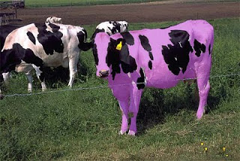


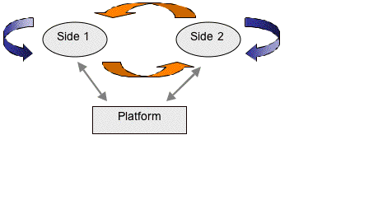
Paid search can be used a tactic to grow the business at the beginning, but might kill the competitive advantage
Relying too much on paid search can make your business indefensible as every company with money can grow their business like yours.
Paid search becomes more expensive over time since it would be more difficult to find the right audience due to saturation.
The longer your campaigns run, the less effective they become as people start seeing your ads too often.
If the product has the network effect (e.g., in two-sided marketspaces), you can use paid search to reach the critical mass (Facebook used paid to grow in new regions)
Notes:
Some companie sspend a GDP of a country,,,,, everyone can do this with money
Organic versus paid
https://andrewchen.co/paid-marketing-addiction/
https://twitter.com/davidsacks/status/475073311383105536?lang=en

Slide 29





Tracking conversions is a very first step for companies to calculate the CAC for different marketing channels
Customer analytics team need to trace back a buyer to the “last touch” attribution source [Google analytics default is last non-direct touch]
If we decide to go with last touch that means the last channel before the customer making the purchase (or become buyers) will get the full credit for that conversion (e.g., sale)
If we feel that last touch is “good enough,” we can use that model for your CAC calculations, if not we might need to use other attribution models.
Last Interaction
First Interaction
Linear
Time decay
Position-based

Slide 30
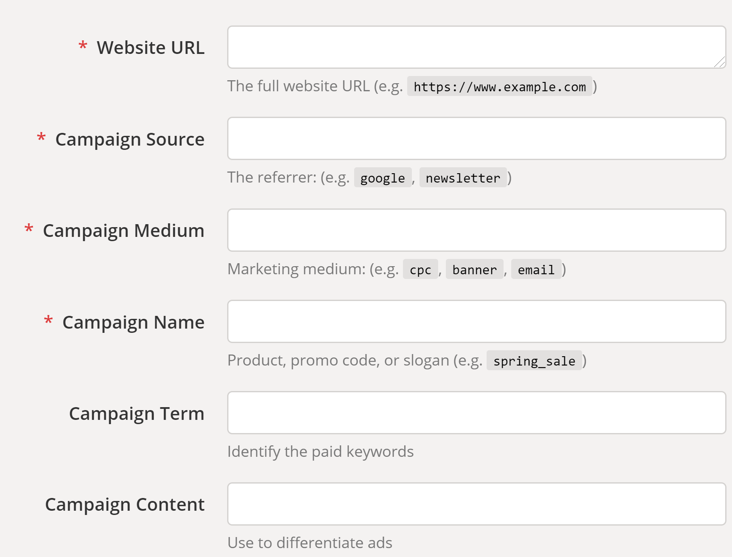
UTM parameters are a great way to see the results of a marketing campaign
A UTM code is a simple code that you can attach to a custom URL in order to track a source, medium, and campaign name
This enables Google Analytics to tell you where searchers came from as well as what campaign directed them to you.
you can simply go to Google’s URL Builder, enter the values for your campaign, and click “generate URL,”
Notes:
https://www.launchdigitalmarketing.com/what-are-utm-codes/

Slide 31
CAC example for different marketing channels
Blended CAC could be misleading!
Calculating CAC at the marketing channel-level is critical [Tracking is the KEY here!]
 | Jan | Feb | Mar | April | May | June | July | Aug | Sept | Oct | Nov | Dec
Total Marketing | $75,000 | $75,000 | $75,000 | $79,000 | $79,000 | $79,000 | $83,000 | $83,000 | $83,000 | $87,000 | $87,000 | $87,000
-- Salaries | $20,000 | $20,000 | $20,000 | $24,000 | $24,000 | $24,000 | $28,000 | $28,000 | $28,000 | $32,000 | $32,000 | $32,000
-- Facebook Ads | $30,000 | $30,000 | $30,000 | $30,000 | $30,000 | $30,000 | $30,000 | $30,000 | $30,000 | $30,000 | $30,000 | $30,000
-- Twitter Ads | $10,000 | $10,000 | $10,000 | $10,000 | $10,000 | $10,000 | $10,000 | $10,000 | $10,000 | $10,000 | $10,000 | $10,000
-- Google Ads | $15,000 | $15,000 | $15,000 | $15,000 | $15,000 | $15,000 | $15,000 | $15,000 | $15,000 | $15,000 | $15,000 | $15,000
Total Expenses | $75,000 | $75,000 | $75,000 | $79,000 | $79,000 | $79,000 | $83,000 | $83,000 | $83,000 | $87,000 | $87,000 | $87,000
New Customers | 555 | 647 | 605 | 640 | 587 | 671 | 654 | 609 | 703 | 646 | 576 | 577
-- FB Customers | 432 | 490 | 456 | 465 | 432 | 456 | 461 | 432 | 490 | 456 | 399 | 433
-- TW Customers | 21 | 25 | 28 | 31 | 23 | 26 | 28 | 23 | 24 | 25 | 23 | 21
-- GOOG Customers | 102 | 132 | 121 | 144 | 132 | 189 | 165 | 154 | 189 | 165 | 154 | 123
Blended CAC | $135 | $116 | $124 | $123 | $135 | $118 | $127 | $136 | $118 | $135 | $151 | $151
-- Facebook CAC | $85 | $75 | $80 | $82 | $88 | $83 | $85 | $91 | $80 | $89 | $102 | $94
-- Twitter CAC | $794 | $667 | $595 | $581 | $783 | $692 | $690 | $841 | $806 | $827 | $899 | $984
-- Google CAC | $212 | $164 | $179 | $160 | $174 | $122 | $147 | $158 | $129 | $156 | $167 | $209
Source: https://brianbalfour.com/essays/average-cac-mistakes-growth
Notes:
https://brianbalfour.com/essays/average-cac-mistakes-growth

Slide 32
Customer analytics team should identify the high-cost and low-cost channels to optimize CAC
Customer analytics should recommend winding-down the high-cost channels while scaling up the low-cost channels.
Word of Caution: This is only CAC, we need to also have LTV to CAC ratio for marketing ROI maximization.

Slide 33
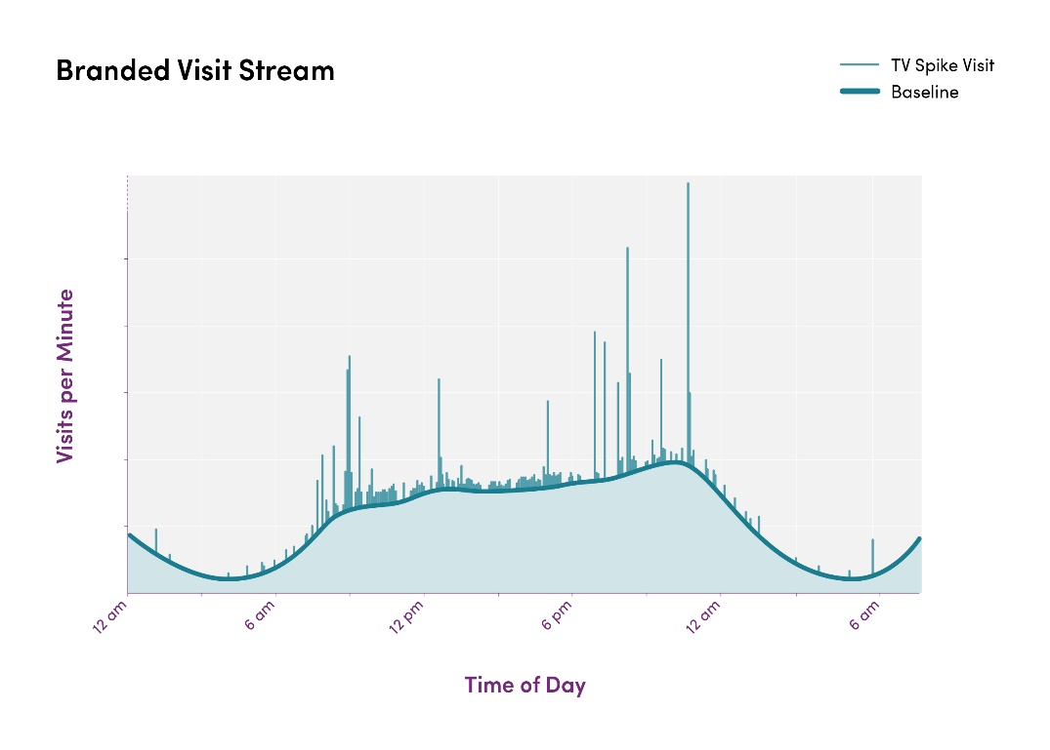
The impact of TV ads and offline campaign is difficult to measure
TV advertising is very expensive, and this makes it one of the most important channels to optimize
Question: is a visitor coming to the site due to the ad, or she would have visited anyway?
Example: Wayfair TV ad
Minute-by-minute count of visitors who arrive at the Wayfair homepage.
Cost per spike visitor (CPSV) is TV spend divided by number of incremental spikes.
Revenue is the one matters the most!
Source: https://tech.wayfair.com/data-science/2018/08/optimizing-tv-advertising-toward-return-on-investment/
Notes:
The first step to counting the extra visitors driven by an individual ad is to model a baseline of site traffic: this is the number of visitors that are expected in the absence of any TV advertising. To get a minute-by-minute count of TV driven spike visitors, we subtract the baseline from the full minute-by-minute visit signal for 3-5 minutes after a TV ad is aired.

Slide 34
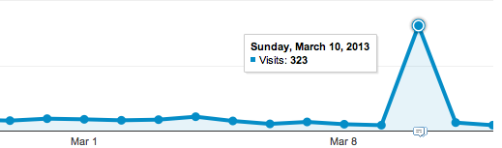

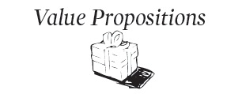


Some ways of improve CAC for your business
Improve on-site conversion across buyer journey: set up goals in google analytics and perform A/B testing to improve the conversions from some call-to-actions (e.g., try different landing pages)
Optimize the mobile site: improve the user experience
(mobile is future!)
Work on your value proposition language and make it easy to understand while compelling enough
Shorten Your Sales Cycle: The faster a new customer is signed, the less time and resources your company has spent acquiring them
Reward referrals: If you can get consistent referrals from existing customers, your average CAC will drop significantly (viral loop)
Notes:
https://www.propellercrm.com/blog/customer-acquisition-cost
https://neilpatel.com/blog/customer-acquisition-cost/

Slide 35
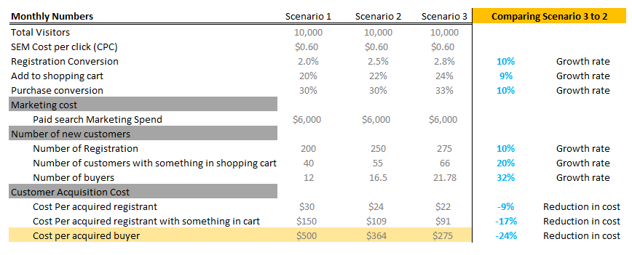
Improving in conversion rates at upper-funnel stages would make the Economics Customer Acquisition (CAC) better
10% improvement in conversion metrics could make the CAC per acquired buyer 25% Cheaper (2X more improvement in cost reduction).

Slide 36
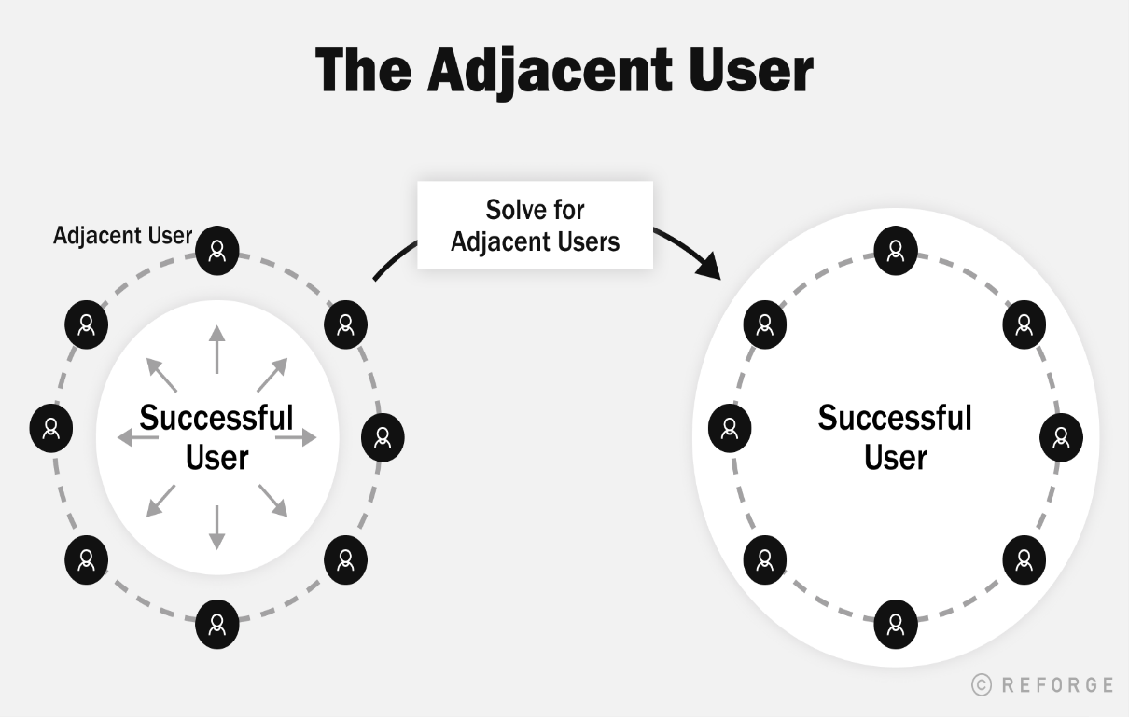
“Adjacent Users” Theory suggest there are some users who show high intent but struggling to adopt or engage
There are a set of users who show intent for your product but are not quite able to get over the hump. Those are your Adjacent Users
You can think about your product as a series of circles.
Each of these circles is defined by the primary user states that someone could be in. For example, Power, Core, Casual, Signed Up, Visitor.
https://andrewchen.com/the-adjacent-user-theory/

Slide 37
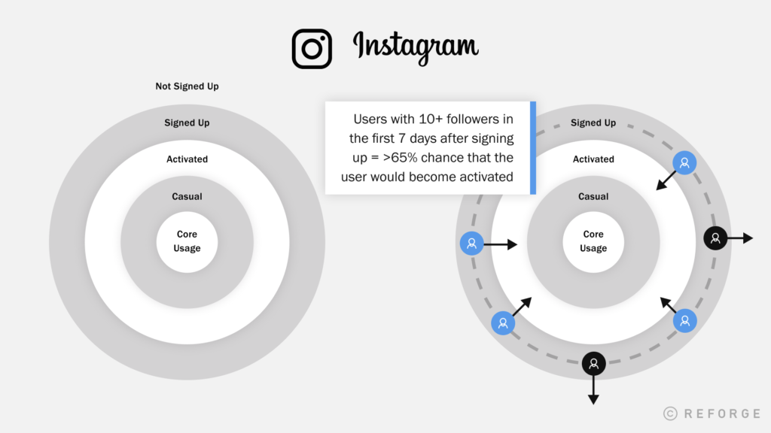
Instagram example of “Adjacent Users”
The primary thresholds that a user has to cross to becoming a core user:
Not Signed Up → Signed Up
Signed Up → Activated
Casual → Core Usage
a user had more than 10 followers in the first 7 days after signing up there was over a 65% chance that the user would become activated.
There was always a group of users on that margin that would struggle to build their audience.
https://andrewchen.com/the-adjacent-user-theory/

Slide 38
In-Class Case Study
(source: https://andrewchen.co/how-to-actually-calculate-cac/)

Slide 39
In-class CAC exercise (Scenario 1)
Scenario 1 | Jan | Feb | Mar | April | May | June | July | Aug | Sept | Oct | Nov | Dec
Marketing Exp. | $10,450 | $11,892 | $12,347 | $12,395 | $13,538 | $10,385 | $10,395 | $13,485 | $12,347 | $13,538 | $12,584 | $12,119
Sales Exp. | $30,122 | $34,321 | $38,943 | $38,234 | $40,438 | $44,784 | $48,348 | $44,321 | $44,756 | $44,943 | $48,218 | $50,326
Total Exp. | $40,572 | $46,213 | $51,290 | $50,629 | $53,976 | $55,169 | $58,743 | $57,806 | $57,103 | $58,481 | $60,802 | $62,445
New Customers | 453 | 485 | 481 | 502 | 509 | 444 | 545 | 589 | 590 | 612 | 690 | 700
CAC | $90 | $95 | $107 | $101 | $106 | $124 | $108 | $98 | $97 | $96 | $88 | $89
CAC = (Marketing Exp + Sales Exp)/New Customers
More realistic situation:
Suppose that it would take on average 60 days for a lead to become a new customer.
How to re-calculate the CAC for above example?

Slide 40
In-class CAC exercise (Scenario 2)
Scenario 1 | Jan | Feb | Mar | April | May | June | July | Aug | Sept | Oct | Nov | Dec
Marketing Exp. | $10,450 | $11,892 | $12,347 | $12,395 | $13,538 | $10,385 | $10,395 | $13,485 | $12,347 | $13,538 | $12,584 | $12,119
Sales Exp. | $30,122 | $34,321 | $38,943 | $38,234 | $40,438 | $44,784 | $48,348 | $44,321 | $44,756 | $44,943 | $48,218 | $50,326
Total Exp. | $40,572 | $46,213 | $51,290 | $50,629 | $53,976 | $55,169 | $58,743 | $57,806 | $57,103 | $58,481 | $60,802 | $62,445
New Customers | 453 | 485 | 481 | 502 | 509 | 444 | 545 | 589 | 590 | 612 | 690 | 700
CAC | $90 | $95 | $107 | $101 | $106 | $124 | $108 | $98 | $97 | $96 | $88 | $89
Assumption in Scenario 2: it would take on average 60 days for a lead to become a new customer
Scenario 2 | Jan | Feb | Mar | April | May | June | July | Aug | Sept | Oct | Nov | Dec
Marketing Exp. | $10,450 | $11,892 | $12,347 | $12,395 | $13,538 | $10,385 | $10,395 | $13,485 | $12,347 | $13,538 | $12,584 | $12,119
Sales Exp. | $30,122 | $34,321 | $38,943 | $38,234 | $40,438 | $44,784 | $48,348 | $44,321 | $44,756 | $44,943 | $48,218 | $50,326
Total Exp. | $40,572 | $46,213 | $51,290 | $50,629 | $53,976 | $55,169 | $58,743 | $57,806 | $57,103 | $58,481 | $60,802 | $62,445
New Customers | 453 | 485 | 481 | 502 | 643 | 444 | 545 | 589 | 590 | 612 | 690 | 700
CAC | n/a | n/a | $84 | $92 | $80 | $114 | $99 | $94 | $100 | $94 | $83 | $84

Slide 41
In-class CAC exercise (Scenario 3)
Scenario 1 | Jan | Feb | Mar | April | May | June | July | Aug | Sept | Oct | Nov | Dec
Marketing Exp. | $10,450 | $11,892 | $12,347 | $12,395 | $13,538 | $10,385 | $10,395 | $13,485 | $12,347 | $13,538 | $12,584 | $12,119
Sales Exp. | $30,122 | $34,321 | $38,943 | $38,234 | $40,438 | $44,784 | $48,348 | $44,321 | $44,756 | $44,943 | $48,218 | $50,326
Total Exp. | $40,572 | $46,213 | $51,290 | $50,629 | $53,976 | $55,169 | $58,743 | $57,806 | $57,103 | $58,481 | $60,802 | $62,445
New Customers | 453 | 485 | 481 | 502 | 509 | 444 | 545 | 589 | 590 | 612 | 690 | 700
CAC | $90 | $95 | $107 | $101 | $106 | $124 | $108 | $98 | $97 | $96 | $88 | $89
Assumption in Scenario 3 : it would take on average 60 days for a lead to become a new customer, however sale expenses would be realized only within last 30 days
Scenario 3 | Jan | Feb | Mar | April | May | June | July | Aug | Sept | Oct | Nov | Dec
Marketing Exp. | $10,450 | $11,892 | $12,347 | $12,395 | $13,538 | $10,385 | $10,395 | $13,485 | $12,347 | $13,538 | $12,584 | $12,119
Sales Exp. | $30,122 | $34,321 | $38,943 | $38,234 | $40,438 | $44,784 | $48,348 | $44,321 | $44,756 | $44,943 | $48,218 | $50,326
Total Exp. | $40,572 | $46,213 | $51,290 | $50,629 | $53,976 | $55,169 | $58,743 | $57,806 | $57,103 | $58,481 | $60,802 | $62,445
New Customers | 453 | 485 | 481 | 502 | 643 | 444 | 545 | 589 | 590 | 612 | 690 | 700
CAC | n/a | n/a | $98 | $101 | $80 | $124 | $110 | $96 | $93 | $95 | $85 | $90

Slide 42
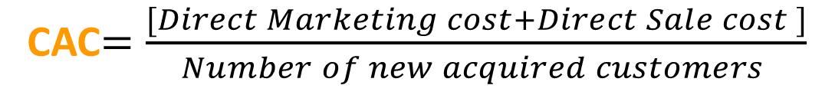
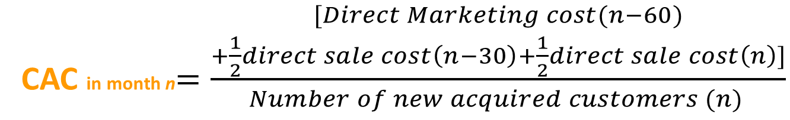
Recap on different definitions of CAC
Basic definition
More advanced
CAC$=\frac{[Direct Marketing cost+Direct Sale cost ]}{Number of new acquired customers }$
n= Current Month
CAC in month n$=\frac{\begin{aligned}[Direct Marketing cost(n−60) \\ +\frac{1}{2}direct sale cost\left(n−30\right)+\frac{1}{2}direct sale cost\left(n\right)]\end{aligned}}{Number of new acquired customers (n) }$

Slide 43
Time between customer’s first interaction (when marketing expenses would get recognized), and involvement of inside sales team changes CAC

Slide 44
The Law of Large number

Slide 45
Growth tends to decay over time even in the best businesses
“If you’re fortunate enough to achieve product-market fit and your business starts to take off, typically, you know, when in the wonderful situation do you get this hyper growth where you’ll grow year over year, you know, it’s triple digits. It’s just exploding. And then gradually the law of the large numbers starts to kick in and maybe the 100% growth becomes 50% growth the next year, and then the law of large numbers continue to kick in and there’s 25% and then it’s 12.5% and so growth tends to decay over time even in the best businesses”
Jeff Jordan, a16z general partners
Source: a16z Podcast: The Basics of Growth — User Acquisition]

Slide 46
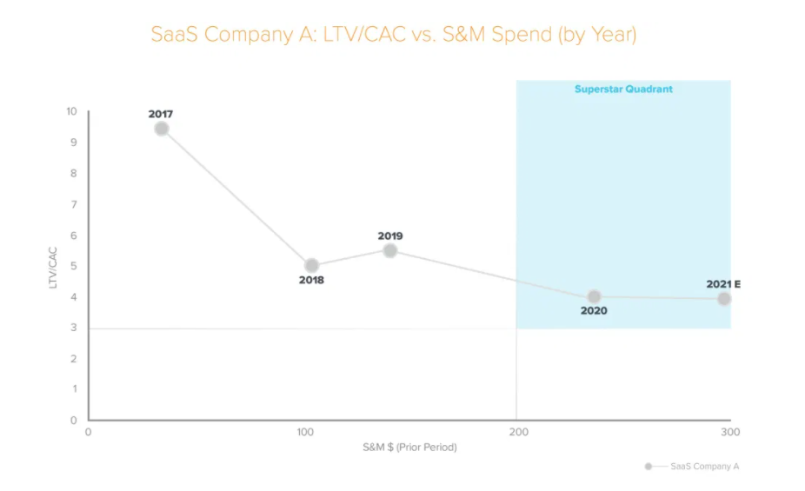
Efficiency vs. Usage demonstration can be helpful to assess the growth health and CAC over time in growth Companies
NBA teams now use efficiency and usage as the metrics that dictate the way they use possessions and how they find superstar players and build their lineups around those superstars.
Many tech companies are starting to use a similar framework when allocating capital against go-to-market (GTM) efforts, often measured as lifetime value (LTV) over customer acquisition costs (CAC).
Using NBA Metrics to Scout Superstar Startups
Source:
Notes:
In basketball and tech in particular, a deeper understanding of efficiency — both in how to measure it and how to leverage that to build winning teams — and usage has changed the game in the last decade. Efficiency is essentially a snapshot view of how well a player or go-to-market team can perform, given some constraint such as cap space or advertising budget, while usage helps us understand how that efficiency will hold up over time.

Slide 47
The importance of Network effects in two-sided marketplace businesses

Slide 48



Business with network effects starts with high CAC and over time CAC decreases due to more users on both sides
A network effect is when new, additional users signing up for a product or service increases its value and utility for current and future users.
If a product or service has a network effect, its value and utility will increase as its user base grows.
The telephone and social networks are good examples of how network effects can impact a product or service.
As more people started using these technologies, they became more valuable, and this brings more user for both side of the marketplace.
Notes:
For example, a new customer for Uber would likely be defined as a new rider who completes their first paid trip. If Uber launches in a new city, they might acquire a new download but since the city is new and there aren’t that many drivers that new potential rider can’t find a driver. This is going to drive overall CAC up in the early days of that city.

Slide 49
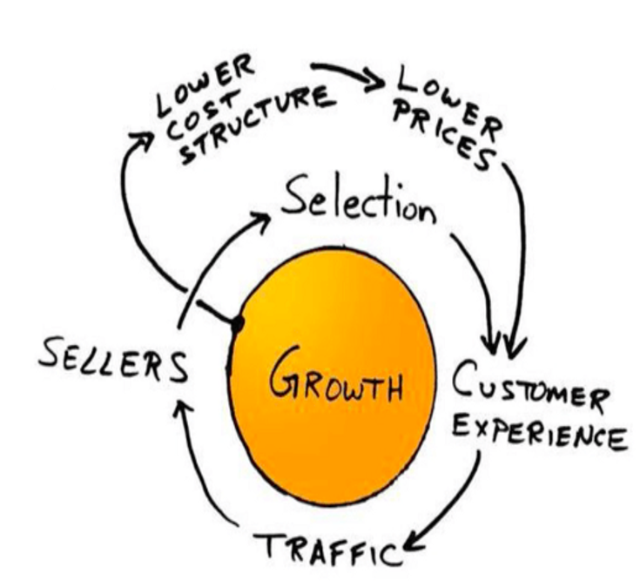
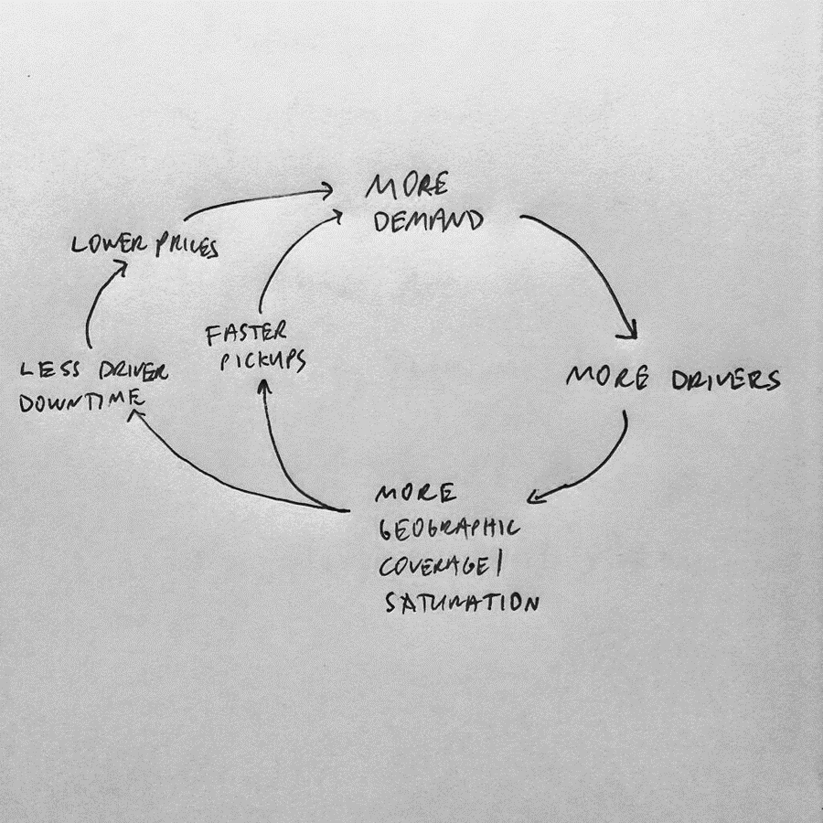
Network effect can act as the growth engine in two-sided marketplace business
Amazon’s Flywheel effect
David Sack’s Famous Napkin Sketch for Uber
Source: https://sellics.com/blog-applying-amazon-flywheel-to-your-online-business/
Source: https://otherspecify.com/2017/02/02/david-sacks-famous-napkin-sketch-for-econ-101/
Notes:
For example, a new customer for Uber would likely be defined as a new rider who completes their first paid trip. If Uber launches in a new city, they might acquire a new download but since the city is new and there aren’t that many drivers that new potential rider can’t find a driver. This is going to drive overall CAC up in the early days of that city.

Slide 50
Homework + reading/listening assignment

Slide 51
HW2 will be posted in the assignment section of BB, 9/16, 8pm EST [Due 9/23, 7pm EST] Please add the list of your project team member @ here
Deliverables for next week

Slide 52
Relevant readings, articles, podcasts and videos
10-min round discussion for next week
Reading: Customer Acquisition cost
Podcast: The Basics of Growth — User Acquisition
Reading: Optimizing TV Advertising Toward Return on Investment
Reading: How To Become A Customer Acquisition Expert
Reading: The 19 Channels You Can Use to Get Traction
Reading: The ‘Oh, Shit!’ Moment When Growth Stops
Reading: The Adjacent User Theory
Extra interesting and relevant content
Reading: Notes on customer acquisition and viral marketing from First Round Capital CEO Summit
Reading: How To (Actually) Calculate CAC
Reading: Your Average CAC is Lying to You -- What to do Instead
Reading: The network effects bible

Slide 53
Questions
Email me @ Alipilehvarm@GWU.edu

